Slide 1
Blockchain-based e-voting systems:
Legal challengesexemplified by German law
Burkhard Schäfer/Tobias J. Schulz

Slide 2
Agenda
1
Introduction
2
Blockchain-based e-voting systems
3
Legal framework in Germany
4
Discussion
5
Summary/Outlook

Slide 3
Agenda
1
Introduction
2
Blockchain-based e-voting systems
3
Legal framework in Germany
4
Discussion
5
Summary/Outlook

Slide 4
Voter fraud hits the news

Slide 5
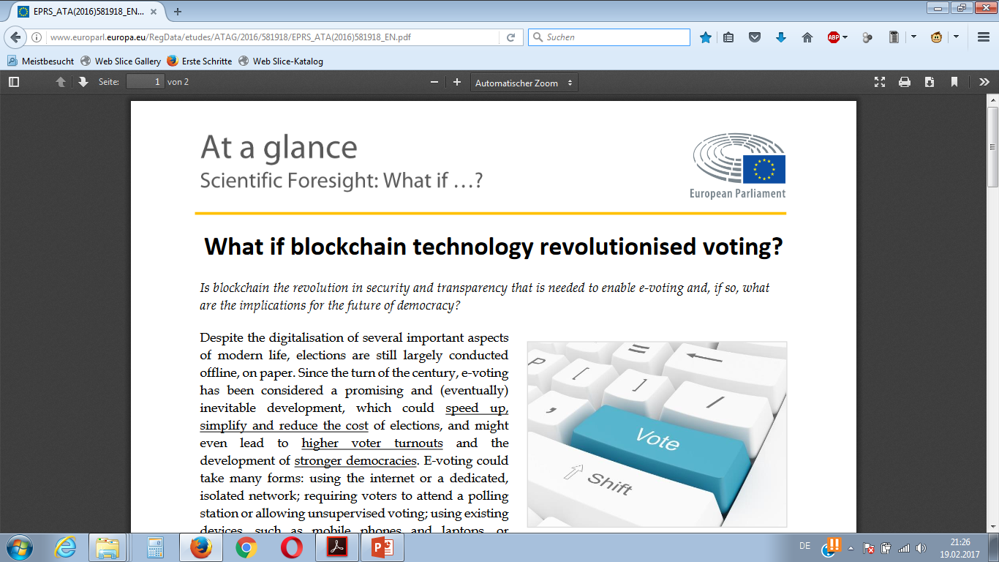

Slide 6
Blockchain-based e-voting systems
Main Characteristics
Two conflicting demands
“Follow my vote”: separated registrars and ID-verifiers
Use of anonymous voter –ID’s to ensure secrecy of the election
Can be used on fixed computers and mobile devices
Legally entitled voters only
Secrecy of the election

Slide 7
Agenda
1
Introduction
2
Blockchain-based e-voting systems
3
Legal framework in Germany
4
Discussion
5
Summary/Outlook

Slide 8
Legal framework in Germany
Art. 38, paragraph 1 Grundgesetz
«Members of the German Bundestag shall be elected in
general, direct, free, equal and secret elections.
They shall be representatives of the whole people, not bound by orders or instructions, and responsible
only to their conscience.»
Additional criterion: Publicity of the election
2009: Judgment of the Constitutional Court regarding “Nedap“ voting machines
Concretisation by §35 Bundeswahlgesetz

Slide 9
Legal framework in Germany
§ 35 Bundeswahlgesetz
(1) Voting machines may be used instead of ballot papers and ballot boxes to facilitate
the casting and counting of votes.
(2) Voting machines as defined in subsection (1) above must guarantee the secrecy of
the ballot. For use at elections to the German Bundestag, their design must be officially
approved for individual elections or on a general basis. The Federal Ministry of the Inter-
ior shall decide on the approval of a voting machine on the application of the manufac-
turer. The permission of the Federal Ministry of the Interior must be obtained before an
officially approved voting machine can be used. This permission may be given for indi-
vidual elections or on a general basis.
[…]

Slide 10
Agenda
1
Introduction
2
Blockchain-based e-voting systems
3
Legal framework in Germany
4
Discussion
5
Summary/Outlook

Slide 11
Legal frameworks
The main challenge 1: Balancing transparency with secrecy
Transparency
Secrecy

Slide 12
Legal frameworks:
The main challenge 2: Balancing inclusivity with integrity
Integrity
Inclusivity

Slide 13
Agenda
1
Introduction
2
Blockchain-based e-voting systems
3
Legal framework in Germany
4
Discussion
5
Summary/Outlook

Slide 14
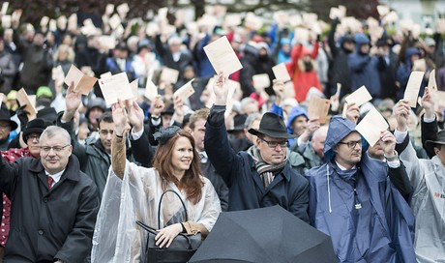
High transparency and integrity, low inclusivity and no secrecy

Slide 15
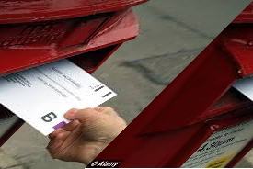
High inclusivity, medium transparency and low integrity

Slide 16
High transparency and integrity, low inclusivity and no secrecy

Slide 17
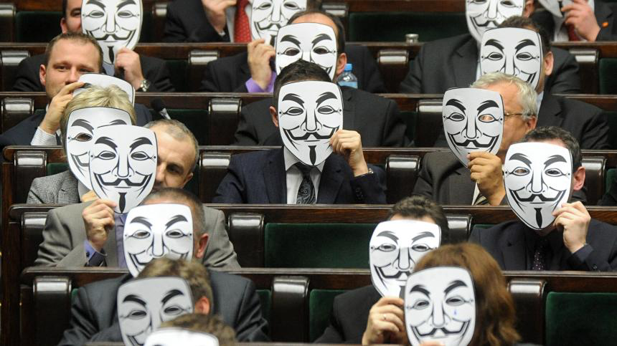
The role of cryptography

Slide 18
Example: Followmyvote

Slide 19
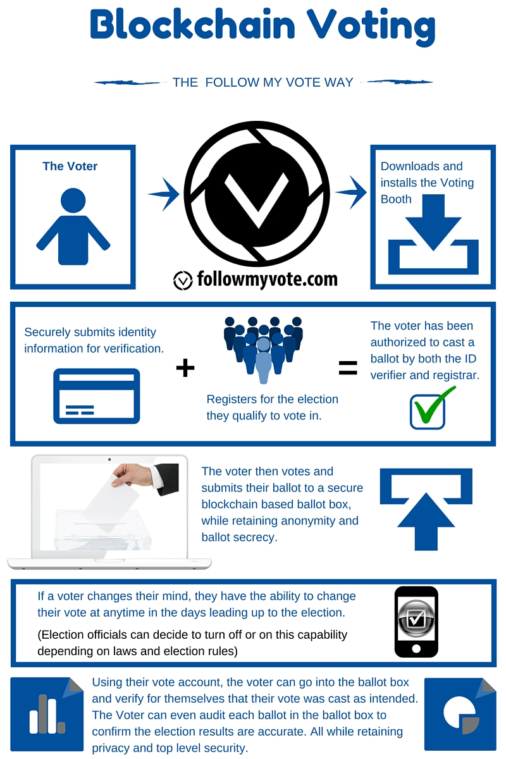

Slide 20
Beyond transparency and secrecy
The problem of early voting and political disengagement.
Changing your vote once it was cast
Incentivizing public participation in the political process

